Slide 1




NarrateIT- Interactive Storytelling
Group 1
Sarala Sharanappa Kanakagiri
Rushitaben Pravinbhai Vachhani
Amisha Bhawsar

Slide 2






Overview
An immersive Java-based application that lets users explore deep, branching narratives through an interactive storytelling experience. The app uses external CSV files to load richly detailed stories, allowing for easy updates and expansion of the narrative content.

Slide 3


KEY FEATURES
Branching Decisions
Navigate through dynamic stories by making meaningful choices at every chapter, shaping your unique storyline.
CSV-Based Content Management
Effortlessly update, expand, or manage narrative content through externally stored CSV files.
Save, Load & History Tracking
This concise layout clearly highlights your app's strengths and makes them easily understandable in a presentation.

Slide 4



Tech Stacks/Libraries / packages
This application leverages Java 17 with Swing to deliver a visually modern, interactive storytelling experience. Key tools and library like flatlaf, OpenCSV, Maven, and GitHub streamline data management, build automation, and version control.
Language: Java 17
UI Framework:
Java Swing
CSV Parsing: Library-OpenCSV
Build Tool: Maven
Version Control:
Git & GitHub

Slide 5
Object-Oriented Concepts
Encapsulation – All classes maintain data privacy using private attributes and public accessors/mutators.
Inheritance – Can be extended further for different types of stories or characters.
Polymorphism – UI components and actions respond differently based on the state (e.g., character role affecting narrative).
Abstraction – Clear separation between UI handling, logic, and data models

Slide 6



DESIGN PATTERNS
MVC (Model-View-Controller)
Model: Story, Chapter, Decision, Character.
View: MainMenuPanel, StoryPanel, CustomizationPanel, etc.
Controller: MainWindow, StoryLoader.
Factory Pattern
Class: UIFactory
Purpose: Creates styled buttons, labels, and UI components dynamically.
Singleton Pattern
Class: Theme
Purpose: Maintains a single instance for theme control (Light/Dark mode) across the app.
Observer Pattern
Example: StoryPanel updates automatically when story changes.
Purpose: UI panels observe state changes (e.g., game history, current chapter).
Strategy Pattern
Concept: Character roles affect story rendering logic dynamically.
Future Scope: Enable different narrative strategies for Adventurer, Wizard, Warrior roles.

Slide 7
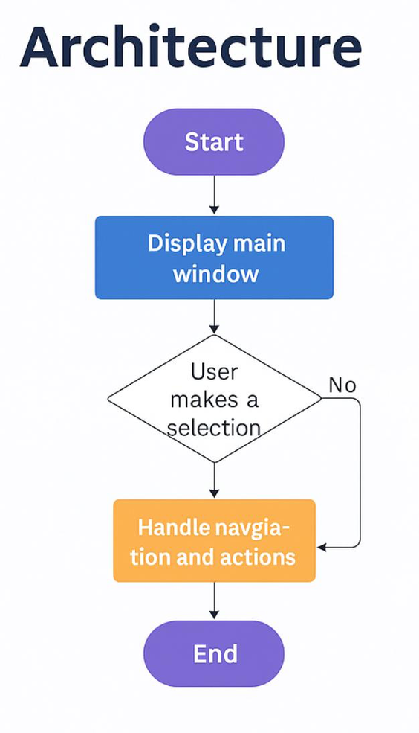
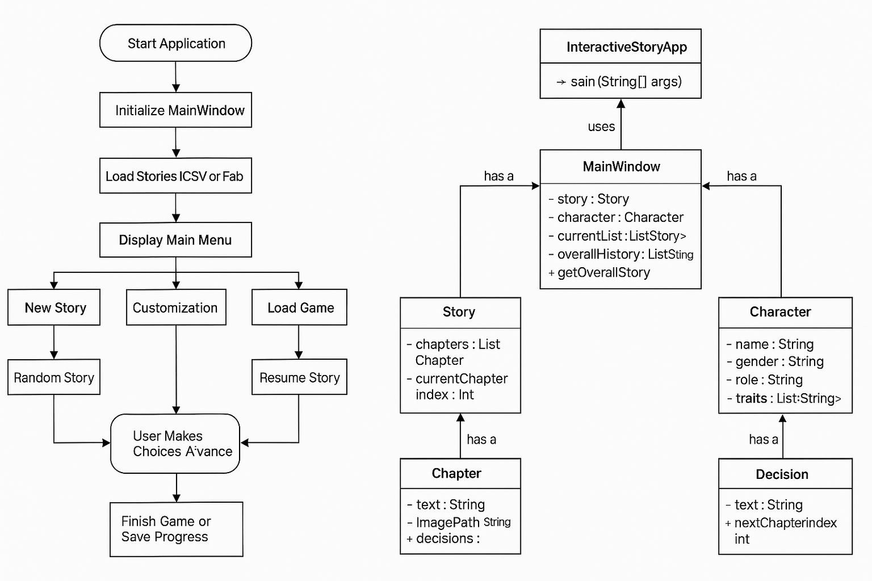
FLOW AND UML DIAGRAM

Slide 8


Operating Instructions
1. Clone the Repository
git clone <link>
cd InteractiveStoryApp
2. Build the Project
Ensure you have Maven installed.
mvn clean install
3. Run the Application
mvn exec:java -Dexec.mainClass="org.example.InteractiveStoryApp"
4. Verify CSV Placement
Ensure that stories.csv is located in:
src/main/resources/stories.csv
This allows the file to be correctly loaded from the classpath.

Slide 9


Future Enhancements
As we continue improving NarrateIT, here are some features we plan to add in the future:
Add Sound and Background Music
To make the storytelling experience more immersive and emotional.
User Login System
So users can save their progress and return to it anytime.
Multiple Story Categories
Like horror, mystery, sci-fi, etc., so users can choose their favorite genre.
More Visual Elements
Like character images, animations, and background themes to make the UI more engaging.

Slide 10


Lesson Learned
Throughout the project, we learned a lot as a team:
Real-World Use of OOP Concepts
We got hands-on experience with applying object-oriented principles in actual code also used concepts from independent research, like:
– How to use OpenCSV for reading story data
Importance of Planning and Testing
We realized how important it is to plan the structure in advance and test every feature as we build.
Handling Errors and Debugging
We learned how to solve unexpected problems and fix bugs effectively.
Understanding User Experience
We focused not only on functionality but also on how users interact with the app.

Slide 11


contributions
Sarala Sharanappa – CStoryLoader and CSV integration, chapter rendering, and decision button interactivity.
Rushitaben Pravin Bhai Vachhani – Code Restructure, Validation, UI/UX Enhancement.
Amisha Bhawsar – Frontend UI Framework design: Java Swing, Validation.

Slide 12

Thank You
FOR YOUR TIME
Fauget Inc.

